Slide 1

Note: The data and information in this document is reflective of a hypothetical situation and client. This document is to be used for KPMG Virtual Internship purposes only.
Sprocket Central Pty Ltd
Data analytics approach
[Division Name] - [Engagement Manager], [Senior Consultant], [Junior Consultant]

Slide 2
Note: The data and information in this document is reflective of a hypothetical situation and client. This document is to be used for KPMG Virtual Internship purposes only.
Agenda
Introduction
Data Exploration
Model Development
Interpretation

Slide 3
Note: The data and information in this document is reflective of a hypothetical situation and client. This document is to be used for KPMG Virtual Internship purposes only.
Introduction
Exploratory Data Analysis for Potential New Customers
Upon analyzing the previous customer data all these points can be concluded:
Females are higher in customer list but almost equal to men, doesn't really give us the information to target which gender in terms of marketing.
More customers are from Manufacturing, Financial and Health industries.
Mass Customers are more than affluent and high net worth customers, they can be targeted.
NSW customers are highest in number.
Solex brand is much popular.
Standard and Medium bicycles are much popular.
Age group 40-60 is much more interested in purchasing bicycles.
All in all it can be said that the new customers dataset resembles the previous one and potentially strong to work on these recommended variables.

Slide 4
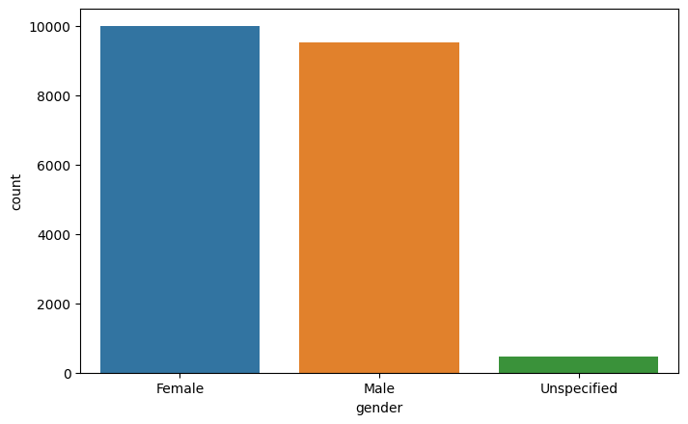
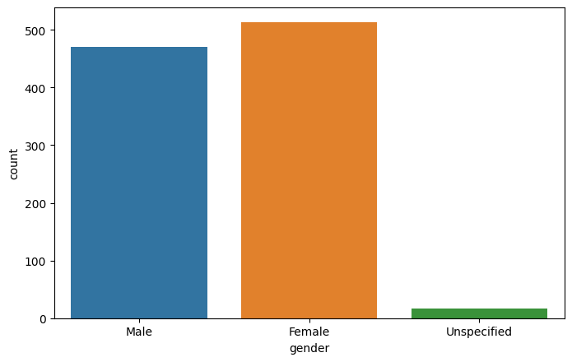
Note: The data and information in this document is reflective of a hypothetical situation and client. This document is to be used for KPMG Virtual Internship purposes only.
Data Exploration
Gender - Comparing the previous customer data vs new customers data, we can say that it would be worthwhile to market to both the genders.
Place any supporting images, graphs, data or extra text here.

Slide 5
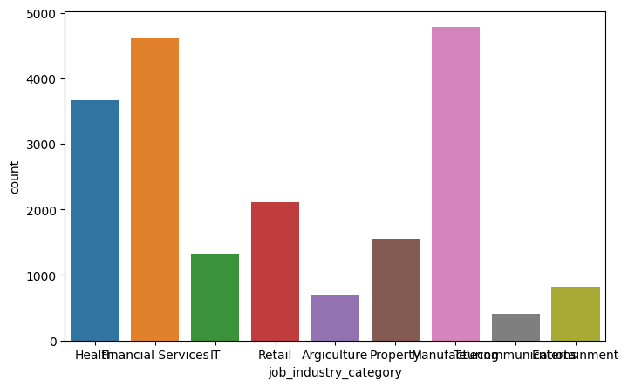
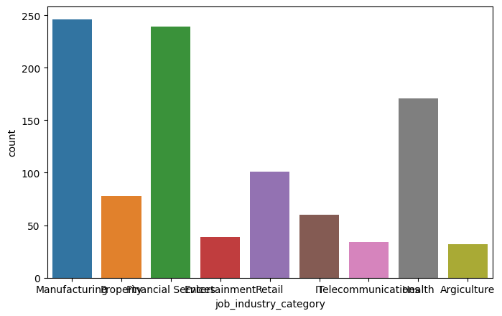
Note: The data and information in this document is reflective of a hypothetical situation and client. This document is to be used for KPMG Virtual Internship purposes only.
Data Exploration
Job Industry Category - Comparing the previous customer data vs new customers data, manufacturing is leading in both of them and it’s recommended to target these customers.
Place any supporting images, graphs, data or extra text here.

Slide 6
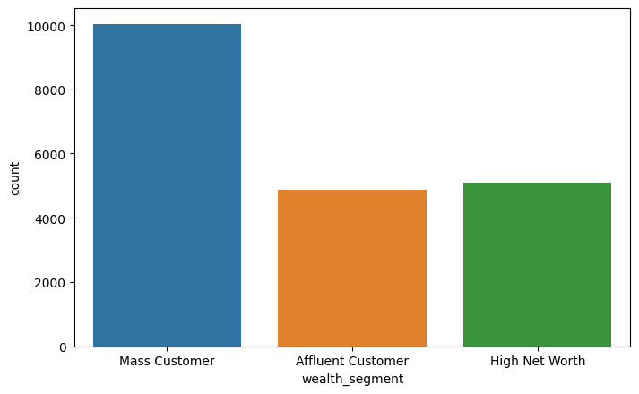
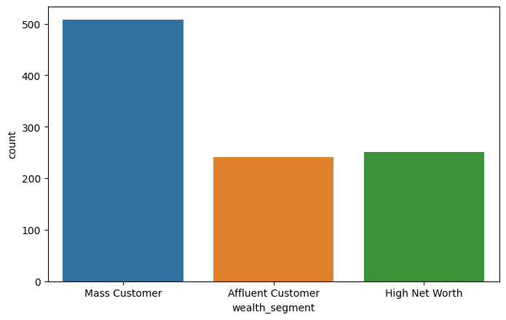
Note: The data and information in this document is reflective of a hypothetical situation and client. This document is to be used for KPMG Virtual Internship purposes only.
Data Exploration
Wealth Segment - Comparing the previous customer data vs new customers data, mass customers is leading in both of them and it’s recommended to target these customers.

Slide 7
Note: The data and information in this document is reflective of a hypothetical situation and client. This document is to be used for KPMG Virtual Internship purposes only.
Model Development
Model development has basically three stages:
Training the model
Testing the model
Evaluating the model
Machine learning models train the datasets given and study the behaviour of each data points to give us appropriate results. Here we will be training our model on the previous customer data and then we will be testing it on the new customers to predict which customer will be a potential customer or not; It helps us prioritize the resources spent on these customers to close the sales.
Evaluating the model involves comparing the predicted results and actual results provided by the company to evaluate and hence improve it to give better results.

Slide 8
Note: The data and information in this document is reflective of a hypothetical situation and client. This document is to be used for KPMG Virtual Internship purposes only.
Interpretation
Machine learning models sometimes can be hard to explain.
Interpretation involves understanding the variables which led the model in making a particular prediction.
This is done by various visualization and feature importance tools present in the models, so that the variables positively impacting the end goal can be targeted and negatively impacting variables can further be improved to ensure overall growth .

